Slide 1
Department of Artificial Intelligence
MINOR PROJECT-3
SKIN DISEASE PREDICTION USING CNN ALGORITHM
TEAM MEMBERS:
I.HARIPRIYA (927621BAD013)
R.JOTHIKA (927621BAD019)
S.KEERTHIKA (927621BAD024)
TEAM GUIDE:
Mr. K. JEYAGANESHKUMAR

Slide 2
ABSTRACT
Objective: Skin is one of the most prominent and largest organs in the body which supports survival and acts as a barrier against injuries, heat and any form of damage that can be caused by Ultra Violate ray. With the help of datasets having the images of skin disease and by using Convolutional Neural Network we are going to predict that the image is cause of Hive disease or not
Methods: To apply Convolutional Neural Network, we have collected the images of the particular disease like HIVES and created a dataset with that images. With the help of CNN algorithm we going to import the dataset and predict whether the image replication is of hives or not.
Novelty: By applying Convolutional Neural Network algorithm we have been able to improve the accuracy of the proposed model. We prove that the CNN model is the most accurate for this type of skin prediction

Slide 3
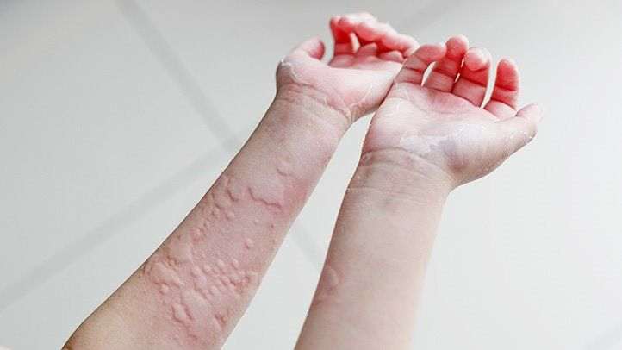
INTRODUCTION
Skin is one of the most prominent and largest organs in the body which supports survival and acts as a barrier against injuries, heat and any form of damage that can be caused by Ultra Violate ray.
Hives often appears as a raised, itchy rash. The medical name for hives is “urticaria.” People also call it welts, wheals, or nettle rash. Hives affects around 20% of people at some time in their lives. The issue can be chronic or acute. Acute hives lasts 6 weeks Trusted Source or less, and it may result from exposure to an allergen or irritant, such as a food or touching a nettle.

Slide 4
PROBLEM STATEMENT
Hives, a skin rash that’s often very itchy, often results from an allergic reaction to food or something you’ve touched. Hives can go away quickly (acute hives) or last a long time (chronic hives) Acute hives are often an allergic reaction to something you put into your body, like food, drink or medication, or something that you touch. The skin has immune cells called mast cells.
By apply Convolutional Neural Network, we have collected the images of the help of CNN algorithm we going to import the dataset and predict whether the image replication is of hives or not.

Slide 5
SOFTWARE REQUIREMENTS
Windows 10
VS code or Brackets
MODULES

Slide 6
EXISTING SYSTEM ARCHITECTURE
There are a number of existing systems for skin disease prediction. These systems typically use a combination of image processing and machine learning techniques to identify and classify skin lesions.
Automatic diagnosis of skin diseases using convolution neural network :
The method proposed in this work detects four types of skin diseases using computer vision. The proposed approach involves Convolutional Neural Networks with specific focus on skin disease.
Derm CNN - Dermatology Diagnosis with Convolutional Neural Networks
Derm CNN is a deep learning-based system designed to assist dermatologists in diagnosing various skin diseases. The system utilizes convolutional neural networks (CNNs) to analyze skin images and provide potential disease predictions.
SkinDx - AI-Powered Skin Disease Diagnosis and Management
SkinDx is an integrated platform that leverages artificial intelligence and machine learning to aid in the diagnosis and management of a wide range of skin diseases.

Slide 7
PROPOSED SYSTEM
By apply Convolutional Neural Network, we have collected the images of the help of CNN algorithm we going to import the dataset and predict whether the image replication is of hives or not.
Collect a diverse dataset of skin images, develop a deep learning model using CNNs, create a user-friendly web/mobile interface for image submission, implement backend processing, and offer predictions with confidence scores. Continuously improve accuracy, maintain privacy, and consider regulatory compliance.

Slide 8
CONCLUSION
The skin disease prediction project, employing Convolutional Neural Networks (CNNs), offers a promising leap in medical image analysis. Through meticulous dataset curation and advanced deep learning, the model demonstrates high accuracy in diagnosing skin conditions. The same way here we have imported images using dataset and predict whether the affected disease is hives or not

Slide 9
REFERENCES
https://www.ijert.org/novel-method-for-dermatological-disease-detection-using-machine-learning
https://www.researchgate.net/publication/338759556_A_Method_Of_Skin_Disease_Detection_Using_Image_Processing_And_Machine_Learning
https://iopscience.iop.org/article/10.1088/1742-6596/1998/1/012037/pdf

